Slide 1
Biological Network Analysis: Example Applications

Slide 2
Example Applications
Network perturbation modeling
Network-based stratification
Gene expression analysis

Slide 3
Example 1: Network Perturbations

Slide 4


Cancer
Normal Tissues
Tumors
Cell Death
Cell Death
Cell Birth
Cell Birth
Accumulating genetic and epigenetic changes result in cancer by altering the balance between cell birth and cell death.
Notes:
Current model of cancer
Cancer results from an increase in the ratio of cell birth to cell death. This results from alterations to the cell’s genome.

Slide 5

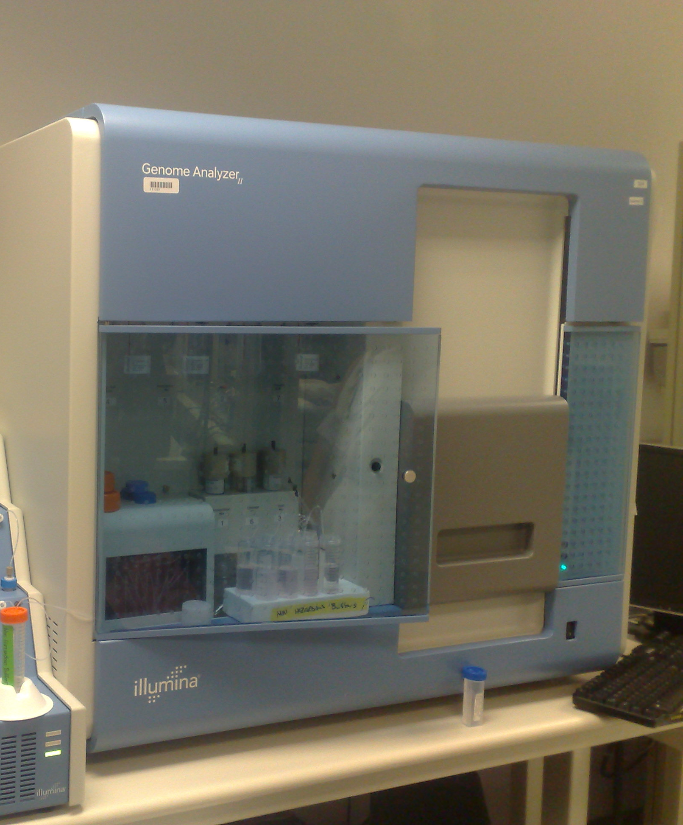

Detecting genetic changes in tumors with DNA sequencing
Tumor DNA
Normal DNA
Sequencing reads
Sequencing reads
Alignment to reference
Alignment to reference
MuTect
eBayes
Strelka
…
Compare
Somatic Mutations
Notes:
We can detect these changes through DNA sequencing – namely we sequence the tumor and normal genomes and look for sites where the tumor shows supporting evidence of a mutation but the germline does not.
Germline mutations can also contribute to cancer risk. The vast majority of known germline cancer mutations result in a higher mutation rate.

Slide 6

Somatic mutations uncovered by large-scale tumor sequencing
Tissue | Samples | Total Mutations | Missense | Silent | Nonsense | Nonstop | Splice | FrameShift | Muts/Samples
SKCM | 228 | 191967 | 117473 | 64243 | 7172 | 49 | 1835 | 1195 | 842
UCEC | 248 | 164832 | 110554 | 38550 | 11525 | 127 | 2569 | 1507 | 665
STAD | 220 | 107998 | 70652 | 29387 | 3548 | 72 | 1555 | 2784 | 491
COAD | 155 | 59332 | 39601 | 14487 | 3274 | 30 | 148 | 1792 | 383
LUAD | 248 | 92281 | 60561 | 22884 | 4805 | 58 | 1874 | 2099 | 372
LUSC | 177 | 63836 | 42529 | 15747 | 3682 | 55 | 1191 | 632 | 361
READ | 73 | 21229 | 14471 | 4629 | 1779 | 6 | 38 | 306 | 291
BLCA | 28 | 7187 | 4686 | 1826 | 418 | 9 | 115 | 133 | 257
CESC | 39 | 8909 | 5620 | 2532 | 474 | 11 | 93 | 179 | 228
HNSC | 306 | 56194 | 36253 | 14136 | 2885 | 53 | 924 | 1943 | 184
LGG | 217 | 25279 | 16460 | 6454 | 1024 | 13 | 453 | 875 | 116
KIRC | 297 | 23656 | 15594 | 5884 | 1076 | 21 | 495 | 586 | 80
GBM | 284 | 20589 | 13461 | 5229 | 809 | 11 | 339 | 740 | 72
KIRP | 114 | 7733 | 4829 | 1725 | 266 | 6 | 178 | 729 | 68
OV | 316 | 19233 | 13164 | 4231 | 800 | 16 | 426 | 596 | 61
PRAD | 83 | 4882 | 3041 | 1368 | 173 | 2 | 88 | 210 | 59
BRCA | 772 | 39427 | 25869 | 8733 | 1984 | 38 | 853 | 1950 | 51
THCA | 323 | 6526 | 4143 | 1573 | 194 | 4 | 125 | 487 | 20
LAML | 196 | 2170 | 1401 | 450 | 108 | 0 | 50 | 161 | 11
Notes:
Table doesn’t include inFrame indels

Slide 7

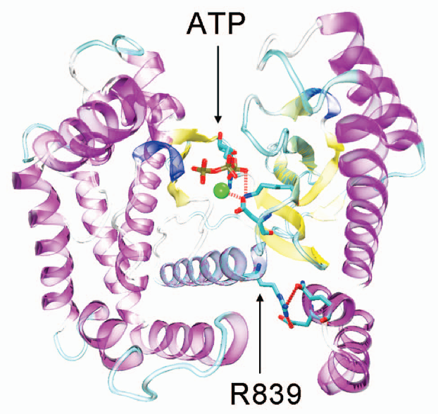

Identifying Driver Mutations in Cancer
VEST
Number of tumors out of 585
Carter et al. Cancer Biology and Therapy 2010
Tumor cohorts & cancer genes
Prioritizing missense mutations

Slide 8
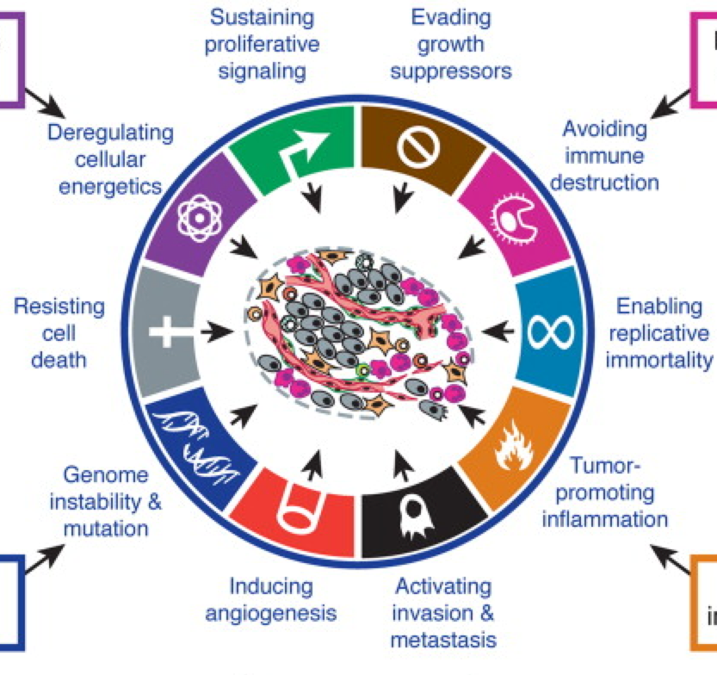
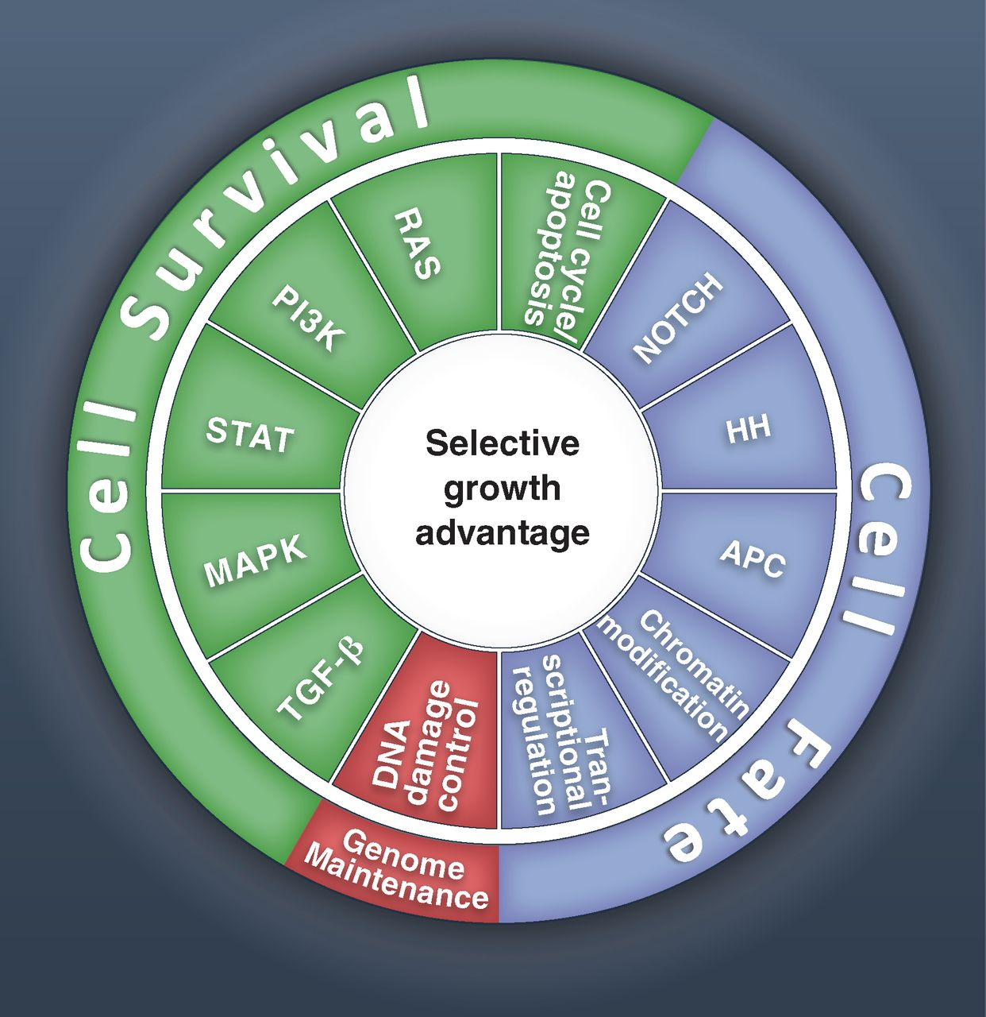
Networks: High genetic heterogeneity – high phenotypic similarity
Hanahan, Weinberg Hallmarks of Cancer: The Next Generation Cell Volume 144, Issue 5, 2011, 646 – 674
B Vogelstein et al. Cancer Genome Landscapes Science 2013, 339, 1546-1558

Slide 9
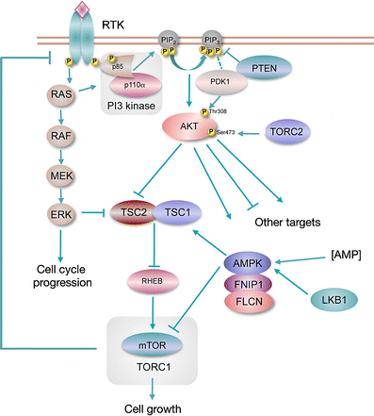
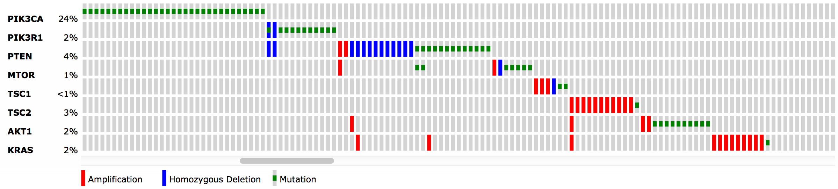
Mutual exclusivity within pathways GBA + Natural Selection
Knowles et al Phosphatidylinositol 3-kinase (PI3K) pathway activation in bladder cancer Cancer and Metastasis Reviews 2009
Breast Invasive Carcinoma (TCGA, Nature 2012)/All Tumors: (825)/User-defined List/8 genes
Notes:
To get this figure, typed names of genes in cbio portal for Nature 2012 BRCA cohort

Slide 10
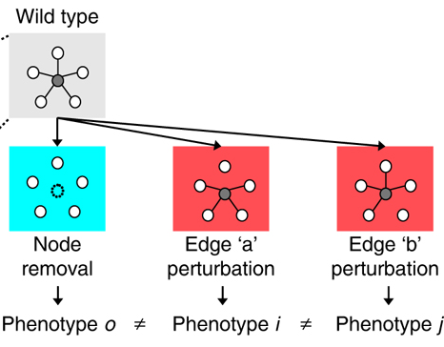
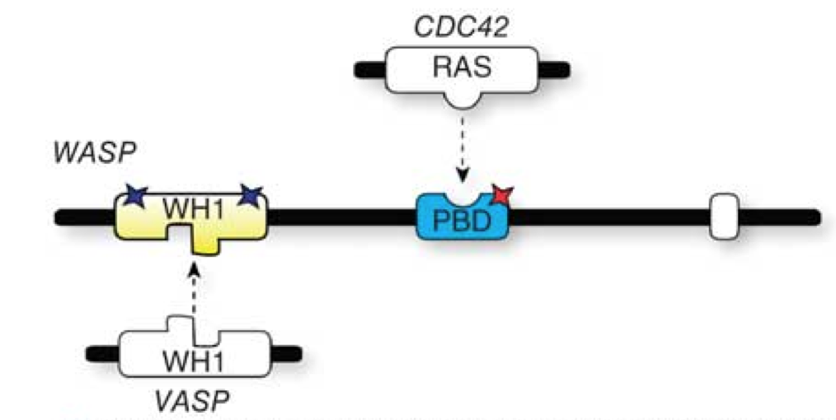
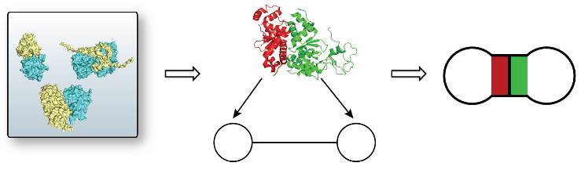
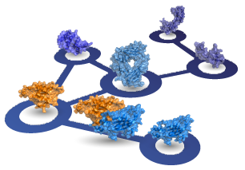
Lessons from Inherited Disease
Edgetic perturbations result in distinct phenotypes (Zhong et al., 2009 )
Disease causing nsSNPs are most enriched at core residues, followed by interface residues. (David et al., 2012)
In-frame disease mutations are enriched on the interfaces (Wang et al., 2012)
Pleiotropy (1 gene – multiple diseases)
Interactome3D (Mosca et al., 2013),
Instruct (Meyer et al., 2013)
Notes:
Mutations in CDC42 binding domain cause X-linked neutropenia
Mutations in VASP binding domain cause Wiskott Aldrich Syndrome and X-linked Thrombocytopenia
Let me begin with introducing you some key concepts related with protein structure. When a mutation occurs on the DNA, it may be carried to RNA and then to protein structure.

Slide 11

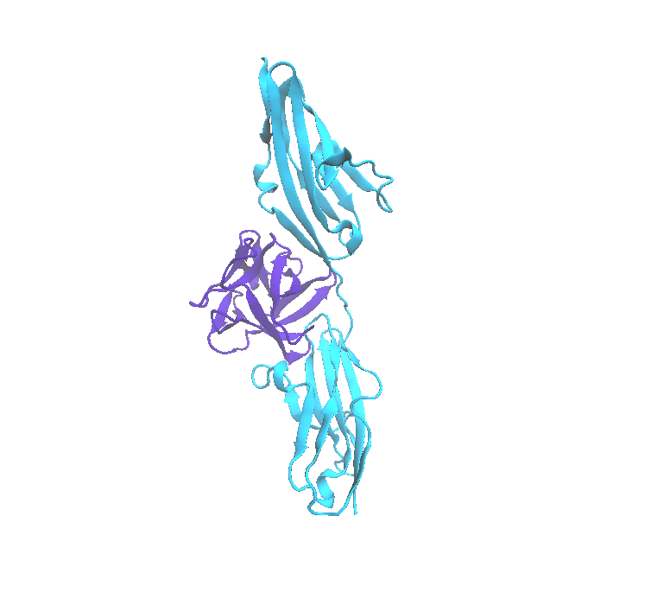
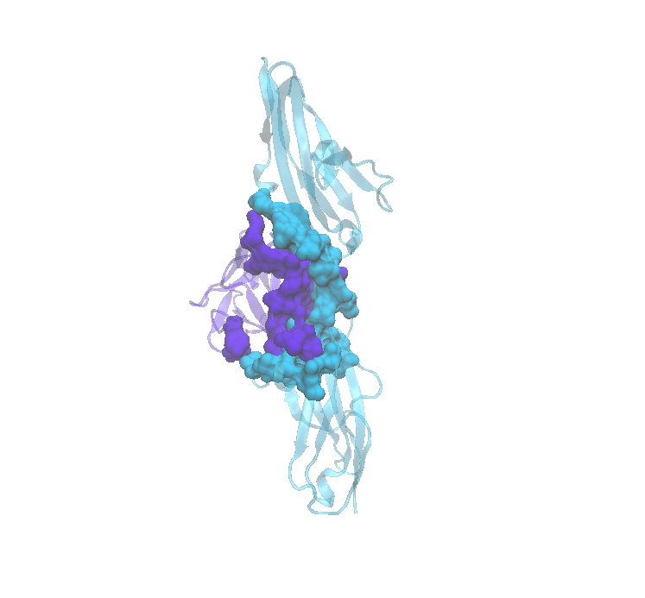
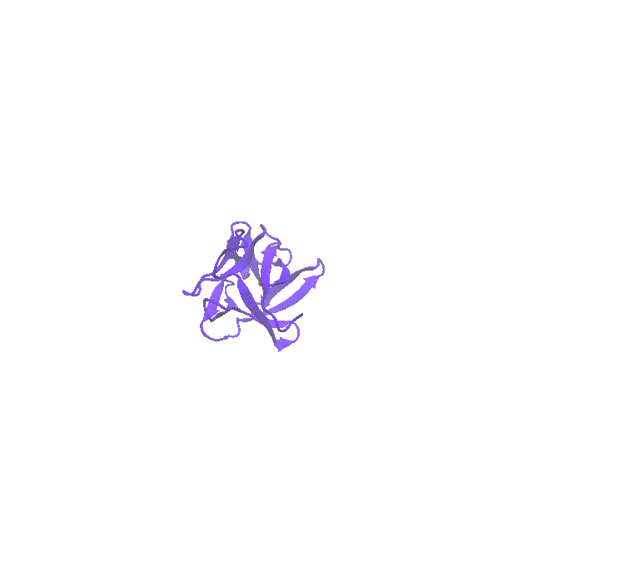
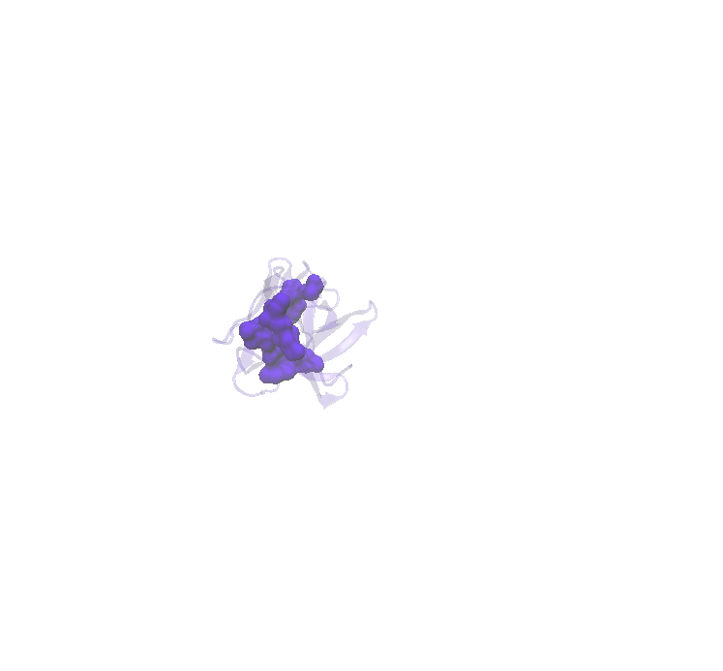
Mapping mutations to residues
Core Residues
Interface Residues
Billur Engin
FGFR1
FGF2
FGF2
Notes:
Here you see FGF2 protein’s structure. A given mutation may happen in one of the core residues or in one of the surface residues. Core residues are hydrophobic and are not exposed to outside, while surface residues are fully exposed to outside and hydrophilic. There are some intermediate residues, which are not fully buried or fully exposed. These residues may be concerned as core or surface in different PDB structures, so we defined an intermediate class for these residues.
Proteins team up together to pursue functions in the cell. Here you see FGF2 protein interacting with FGFR1 protein as an example. The physical contact region between two proteins are called “the interface”. The residues in the core are responsible for the stability of the protein, while the interface residues are important for maintaining the interaction. The energy distribution in the interface is not homogenous, there are some residues which contribute more to the binding free energy, These proteins are called hotspots. A mutation that would happen on a hotspot would most probably alter the interaction. Most of the PPI targeting drugs bind to hotspot residues to hinder the protein interaction.

Slide 12
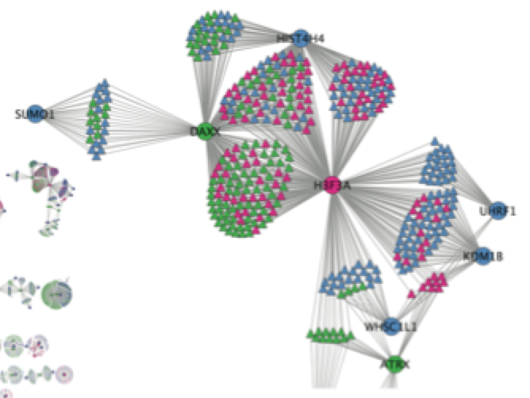
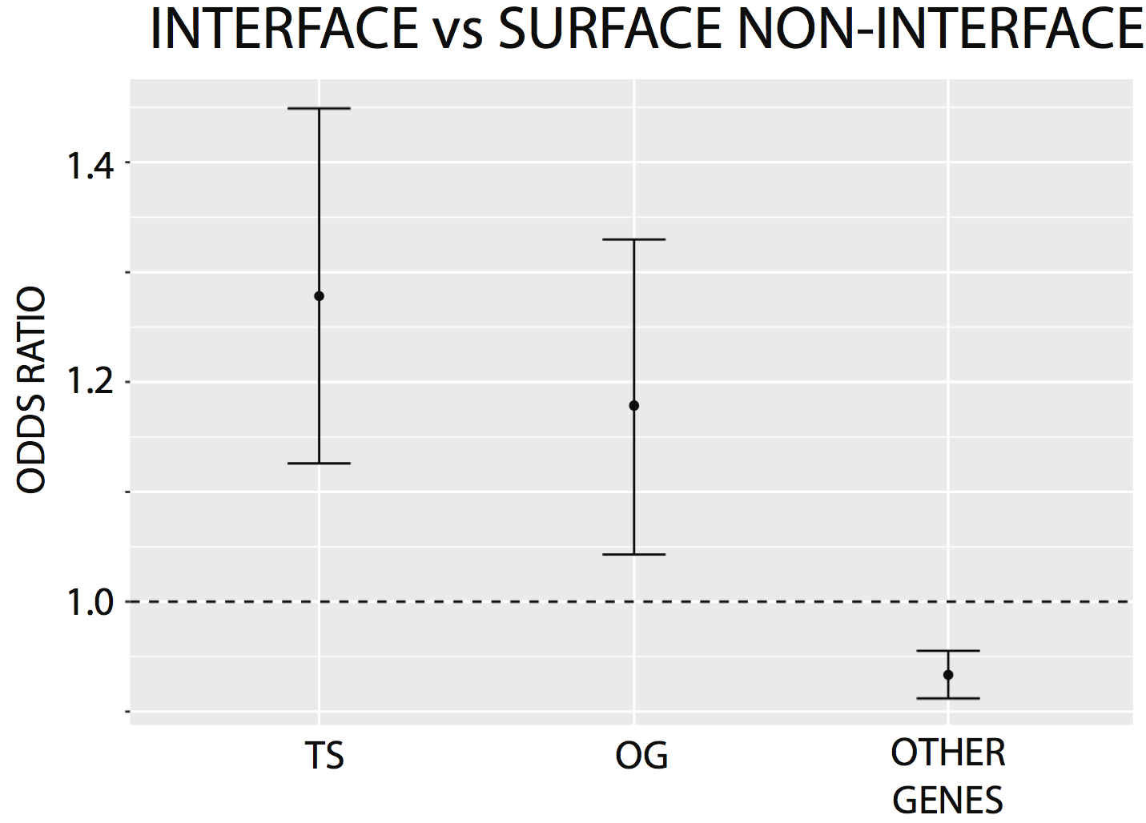
Studying cancer mutations using a structurally resolved network
Inter
Proteins
Interface Residues
Engin et al. PLOS One 2016

Slide 13
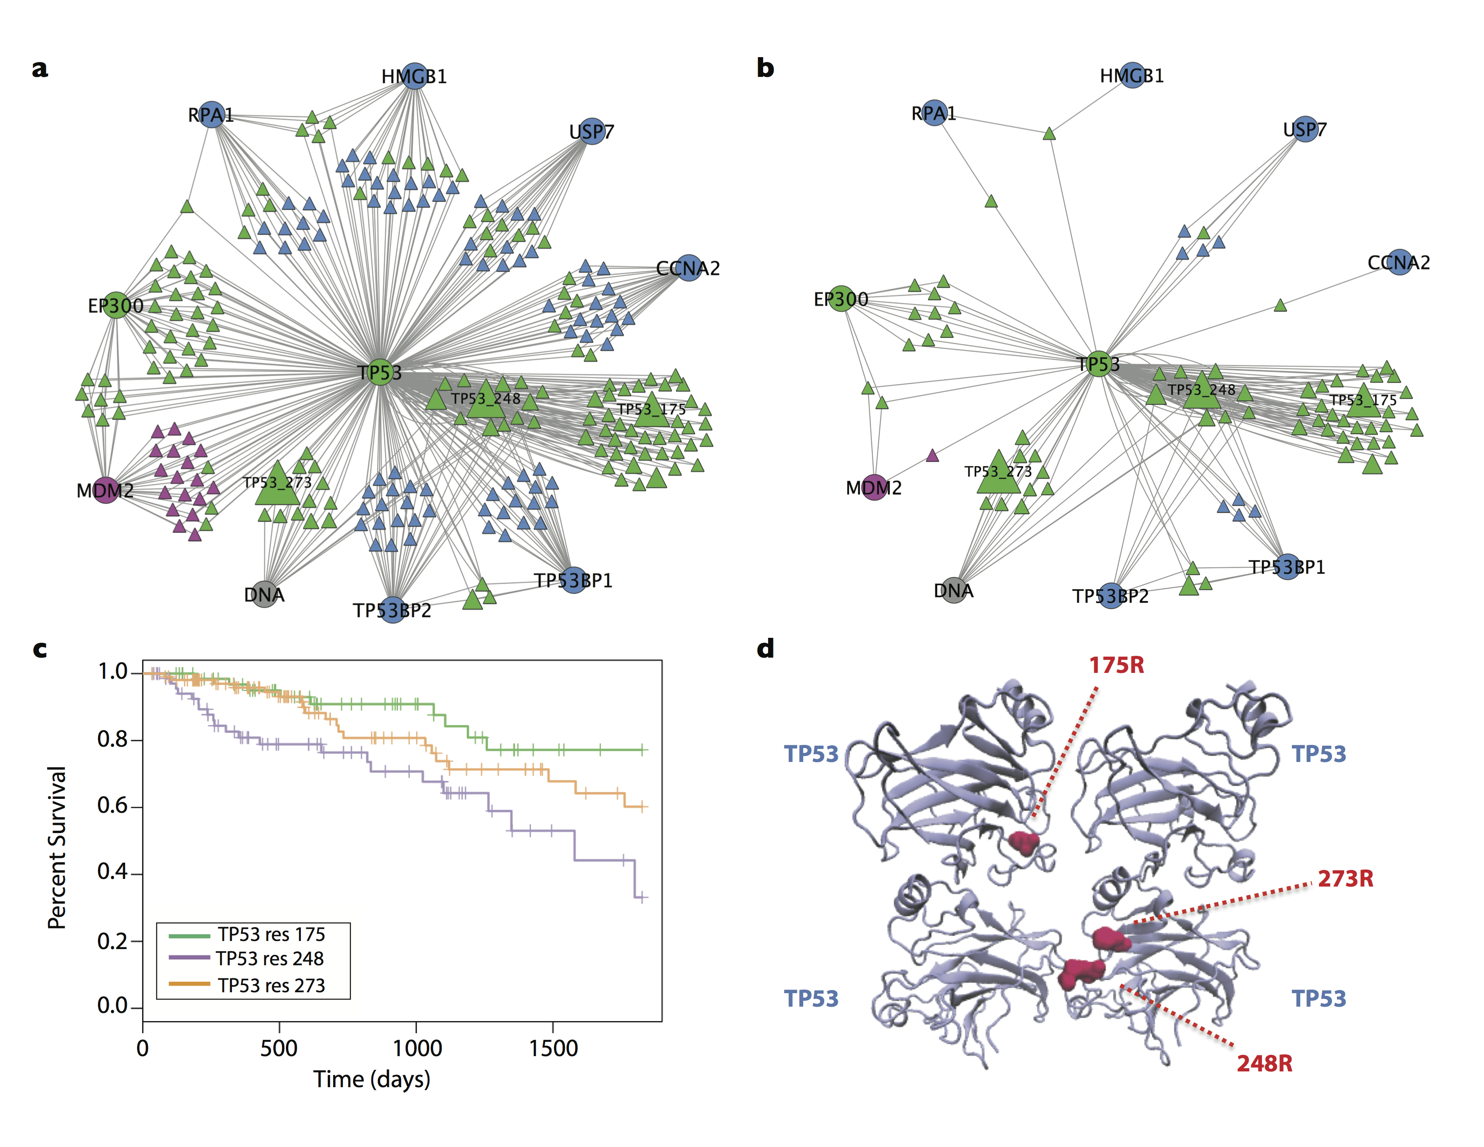
Studying cancer mutations using a structurally resolved network
p < 0.004
Engin et al. PLOS One 2016

Slide 14
Analysis of Cancer Mutations in Driver Genes using a Hybrid PPI Network
Human PPI network (STRING, HINT, PDB) : 11943 proteins, 74558 PPIs
Structural data from PDB for 125 driver genes (Vogelstein et al., 2013)
97 proteins , 147 complexes
TCGA data 28 types of tumor tissue, 399 of mutations mapped to PDB structures, 1094 of patients
Notes:
kac hasta var tcga’de normalde

Slide 15
Analysis of mutation-specific consequences using a hybrid PPI network
Human PPI network (STRING, HINT, PDB) : 11943 proteins, 74558 PPIs
Structural data for 97 driver genes covering 137 distinct core or protein interface localized mutation clusters
Notes:
TCGA data 28 types of tumor tissue, 399 of mutations mapped to PDB structures, 1094 of patients

Slide 16
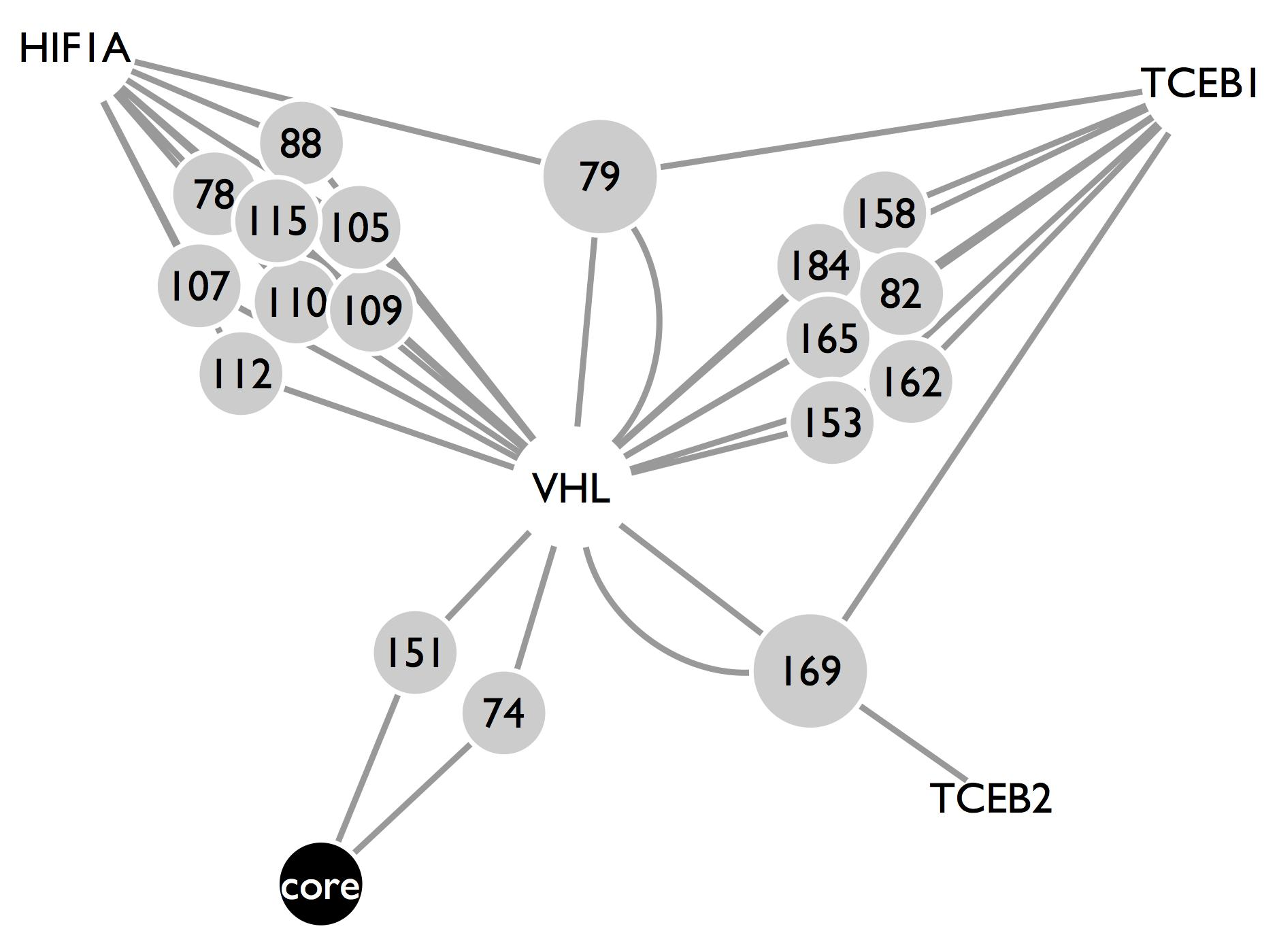
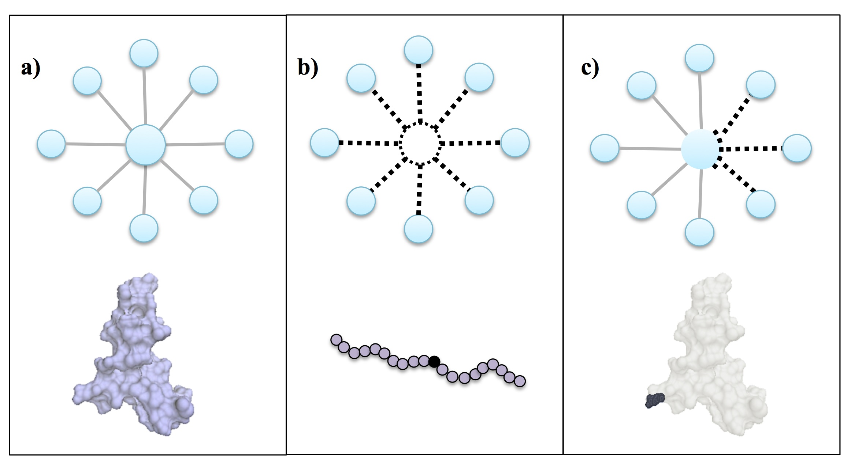
VHL has 5 distinct mutation clusters
Wild Type
Core mut.
Interface mut.

Slide 17
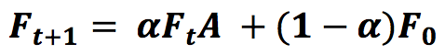
Implementing mutations as network perturbations
Network Perturbation
Network Propagation
(Vanunu et al., 2010; Hofree et al.,2013)
Wild Type
Core mut.
Interface mut.
Sub-network Extraction
Guilt by association
Functional Annotation
Mut A
Mut B
Identify functions that are specific to a particular mutation
Engin et al., PSB 2015

Slide 18
43 drivers with mutations at distinct sites
Genes | # of Distinct Mutations | Genes | # of Distinct Mutations
CTNNB1 | 11 | SMAD4 | 2
APC | 7 | CASP8 | 2
PPP2R1A | 6 | ABL1 | 2
EGFR | 6 | FLT3 | 2
TP53 | 6 | PIK3CA | 2
VHL | 5 | CSF1R | 2
DAXX | 5 | KDM6A | 2
FGFR2 | 5 | CDH1 | 2
B2M | 4 | FBXW7 | 2
RB1 | 4 | CDKN2A | 2
MSH2 | 3 | MSH6 | 2
MEN1 | 3 | BCOR | 2
SMAD2 | 3 | ATRX | 2
DNMT3A | 3 | FGFR3 | 2
AXIN1 | 3 | MLL3 | 2
PIK3R1 | 3 | ERBB2 | 2
HRAS | 3 | PTPN11 | 2
BRCA1 | 3 | KIT | 2
H3F3A | 3 | MET | 2
SPOP | 3 | RUNX1 | 2
NOTCH1 | 3 | CREBBP | 2
CBL | 3
Functional annotations of the residue mutations of 5 proteins were validated via literature
Engin et al., PSB 2015
Notes:
Min (P1, P2)
Top 10th percentile
1000 random (core + interface muts)
1 gene-set per mutation

